Slide 1
PARKING MANAGEMENT SYSTEM

Slide 2
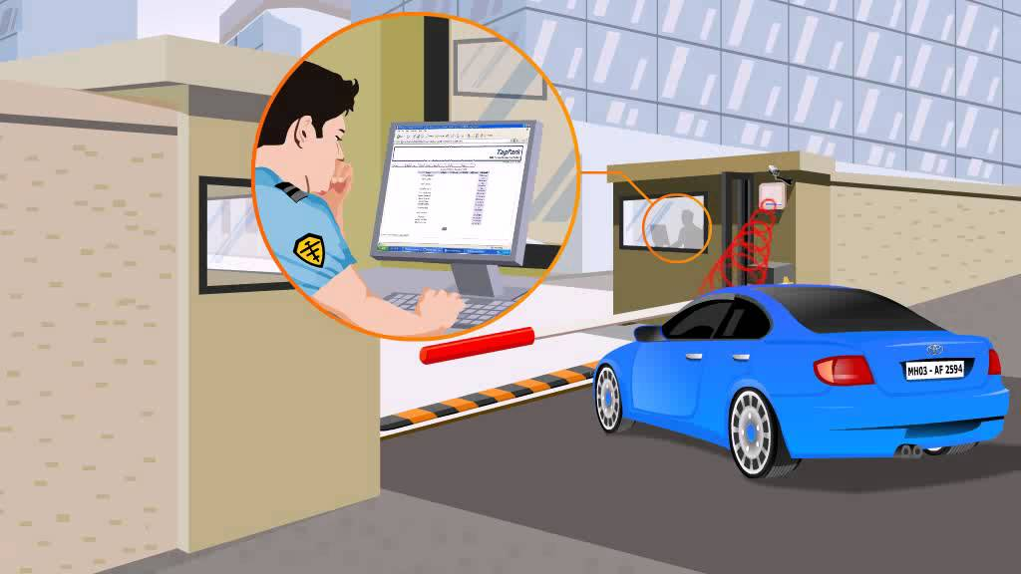

Slide 3
Introduction
Parking Management System is developed to support the customers and also the management of parking with a flexible and Hassle-free experience. The system enables the customer to make registrations and reservations for parking of their vehicles. To avoid the problem of road jamm, Parking Management System is useful for both the customers and the management. In this system all the events are managed by the Admin only. Admin adds, delete and update the information in the program. In the availability of parking slot of the vehicles, the customer can simply go to that parking place and park the vehicle thereby creating a hassle free experience.

Slide 4
Objectives
To reduce heavy traffic congestion,
To create more saleable space,
To provide more security,
To reduce the unwanted spaces for other purpose,
To enhance the development of the country,
To provide a systematic and flexible system,
To increase revenue

Slide 5
Thank You

